Slide 1
Restful Web Services

Slide 2
Restful Webservices?
REST is the acronym for REpresentational State Transfer.
It is an architectural style for developing applications that can be accessed over the network.
REST web services are resources and can be identified by their URIs.
REST Client applications can use HTTP GET/POST methods to invoke Restful web services.
When compared to SOAP web services, these are lightweight and don’t follow any standard
We can use XML, JSON, text or any other type of data for request and response.

Slide 3
Java RESTful Web Services API
JAX-RS is the Java API for creating REST web services.
It uses annotations to simplify the development and deployment of web services.
JAX-RS is part of JDK, so you don’t need to include anything to use it’s annotations.

Slide 4
Restful Web Services Annotations
@Produces, @Consumes: used to specify the request and response types.
Mostly used JAX-RS annotations are:
@Path: used to specify the relative path of class and methods. We can get the URI of a webservice by scanning the Path annotation value.
@GET, @PUT, @POST, @DELETE and @HEAD: used to specify the HTTP request type for a method.
@Produces, @Consumes: used to specify the request and response types.
@PathParam: used to bind the method parameter to path value by parsing it.

Slide 5
****Restful and SOAP Web services
SOAP is a protocol whereas REST is an architectural style.
SOAP server and client applications are tightly coupled and bind with the WSDL contract whereas there is no contract in REST web services and client.
Learning curve is easy for REST when compared to SOAP web services.
REST web services request and response types can be XML, JSON, text etc. whereas SOAP works with XML only.
JAX-RS is the Java API for REST web services whereas JAX-WS is the Java API for SOAP web services.

Slide 6
REST API Implementations
There are two major implementations of JAX-RS API.
Jersey: Jersey is the reference implementation provided by Sun. For using Jersey as our JAX-RS implementation, all we need to configure its servlet in web.xml and add required dependencies. Note that JAX-RS API is part of JDK not Jersey, so we have to add its dependency jars in our application.
RESTEasy: RESTEasy is the JBoss project that provides JAX-RS implementation.

Slide 7
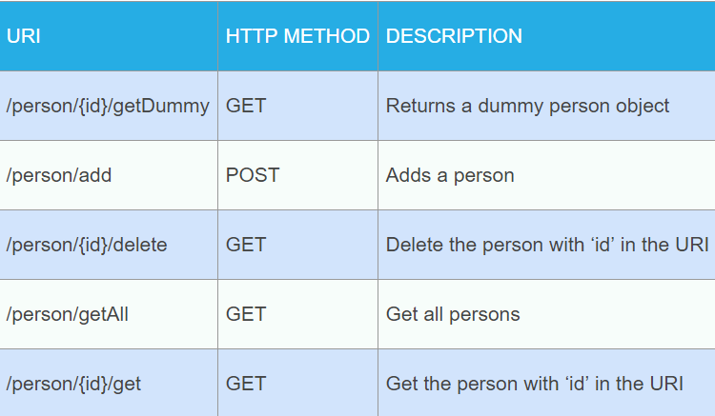
Let’s create Restful web services using Jersey and then RESTEasy.
We will be exposing following methods over HTTP and use Chrome Postman extension to test these.

Slide 8
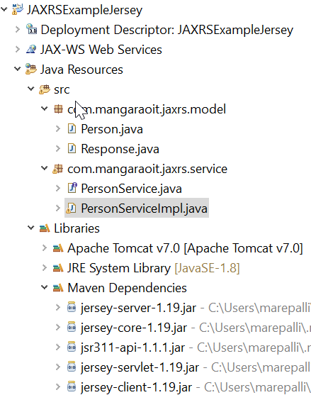
Jersey Restful Web Services Example
Create a dynamic web project and then convert it to Maven to get the skeleton of your web services project. Below image shows the project structure of the final project.

Slide 9
Let’s add Jersey dependencies in pom.xml file.
<dependencies>
<dependency>
<groupId>com.sun.jersey</groupId>
<artifactId>jersey-server</artifactId>
<version>1.19</version>
</dependency>
<dependency>
<groupId>com.sun.jersey</groupId>
<artifactId>jersey-servlet</artifactId>
<version>1.19</version>
</dependency>
<dependency>
<groupId>com.sun.jersey</groupId>
<artifactId>jersey-client</artifactId>
<version>1.19</version>
</dependency>
</dependencies>

Slide 10
Note:
We are not required to add jersey-client dependencies but if you are writing java program to invoke a REST web service using Jersey then it’s required.

Slide 11
configure Jersey in web.xml Notice the value of init parameter com.sun.jersey.config.property.packages to provide package that will be scanned for web service resources and methods.
<!-- Jersey Servlet configurations -->
<servlet>
<servlet-name>Jersey REST Service</servlet-name>
<servlet-class>com.sun.jersey.spi.container.servlet.ServletContainer</servlet-class>
<init-param>
<param-name>com.sun.jersey.config.property.packages</param-name>
<param-value>com.mangaraoit</param-value>
</init-param>
<load-on-startup>1</load-on-startup>
</servlet>
<servlet-mapping>
<servlet-name>Jersey REST Service</servlet-name>
<url-pattern>/*</url-pattern>
</servlet-mapping>
<!-- Jersey Servlet configurations -->

Slide 12
REST Example Model Classes
First of all we will create two model beans – Person for our application data and Response for sending response to client systems.
Since we will be sending XML response, the beans should be annotated with @XmlRootElement, hence we have this class.

Slide 13
Person.java
package com.mangaraoit.jaxrs.model;
import javax.xml.bind.annotation.XmlRootElement;
@XmlRootElement(name="person")
public class Person {
private int id;
private String name;
private int age;
//setters and getters
}

Slide 14
Response.java
package com.mangaraoit.jaxrs.model;
import javax.xml.bind.annotation.XmlRootElement;
@XmlRootElement
public class Response {
private boolean status;
private String message;
//setters and getters

Slide 15
PersonService.java Based on our URI structure, below is the service interface and it’s implementation code.
package com.mangaraoit.jaxrs.service;
import com.mangaraoit.jaxrs.model.Person;
import com.mangaraoit.jaxrs.model.Response;
public interface PersonService {
public Response addPerson(Person p);
public Response deletePerson(int id);
public Person getPerson(int id);
public Person getDummyPerson(int id);
public Person[] getAllPersons();
}

Slide 16
PersonServiceImpl.java
package com.mangaraoit.jaxrs.service;
import java.util.HashMap;
import java.util.Map;
import java.util.Set;
import javax.ws.rs.Consumes;
import javax.ws.rs.GET;
import javax.ws.rs.POST;
import javax.ws.rs.Path;
import javax.ws.rs.PathParam;
import javax.ws.rs.Produces;
import javax.ws.rs.core.MediaType;
import com.mangaraoit.jaxrs.model.Person;
import com.mangaraoit.jaxrs.model.Response;
@Path("/person")
@Consumes(MediaType.APPLICATION_XML)
@Produces(MediaType.APPLICATION_XML)
public class PersonServiceImpl implements PersonService {
private static Map<Integer, Person> persons = new HashMap();

Slide 17
@Override
@POST
@Path("/add")
public Response addPerson(Person p) {
Response response = new Response();
if (persons.get(p.getId()) != null) {
response.setStatus(false);
response.setMessage("Person already exists");
return response;
}
persons.put(p.getId(), p);
response.setStatus(true);
response.setMessage("Person is created successfully");
return response;
}

Slide 18
@Override
@GET
@Path("/{id}/delete")
public Response deletePerson(@PathParam("id") int id) {
Response response = new Response();
if (persons.get(id) == null) {
response.setStatus(false);
response.setMessage("Person doesn't exist");
return response;
}
persons.remove(id);
response.setStatus(true);
response.setMessage("Person deleted successfully");
return response;
}

Slide 19
@Override
@GET
@Path("{id}/get")
public Person getPerson(@PathParam("id") int id) {
return persons.get(id);
}
@Override
@GET
@Path("{id}/getDummy")
public Person getDummyPerson(@PathParam("id") int id) {
Person p = new Person();
p.setId(id);
p.setName("Dummy");
p.setAge(20);
return p;
}

Slide 20
@Override
@GET
@Param("/getAll")
public Person[] getAllPersons() {
Person[] p = new Person[persons.size()];
Set<Integer> personIds = persons.keySet();
int i = 0;
for (Integer id : personIds) {
p[i++] = persons.get(id);
}
return p;
}

Slide 21
Restful Web Services Test
That’s it. Our web service is ready, Just deploy the application in web server
Below are some of the tests performed using Postman chrome extension for this web service. Note that we have to provide Accept and Content-Type values as “application/xml” in request header as shown in below image.

Slide 22
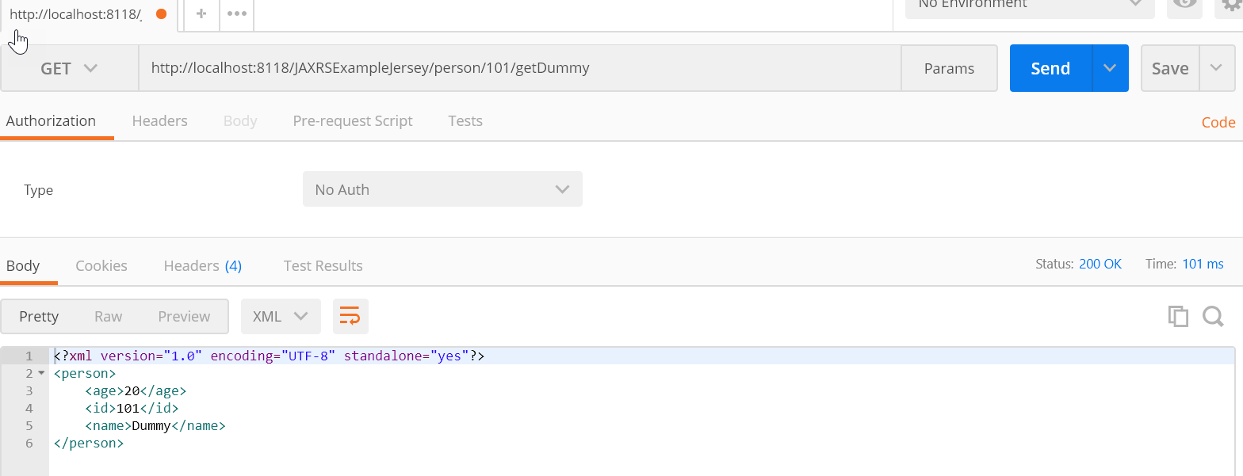
getDummy

Slide 23
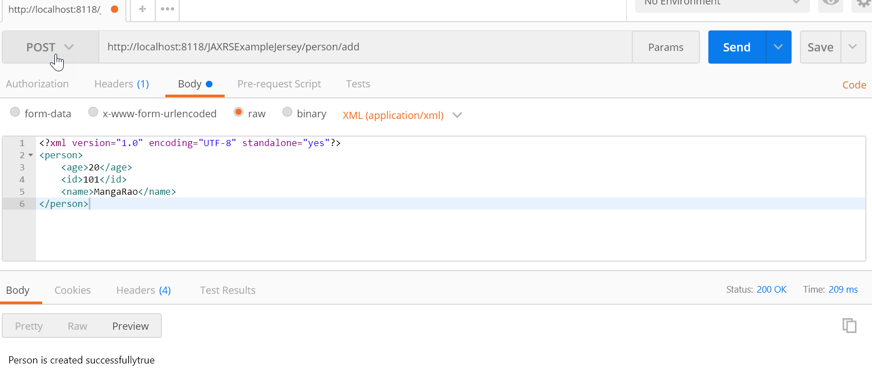
add

Slide 24
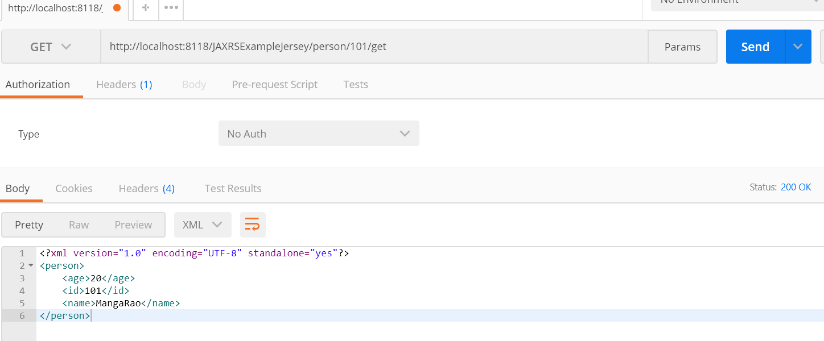
get

Slide 25
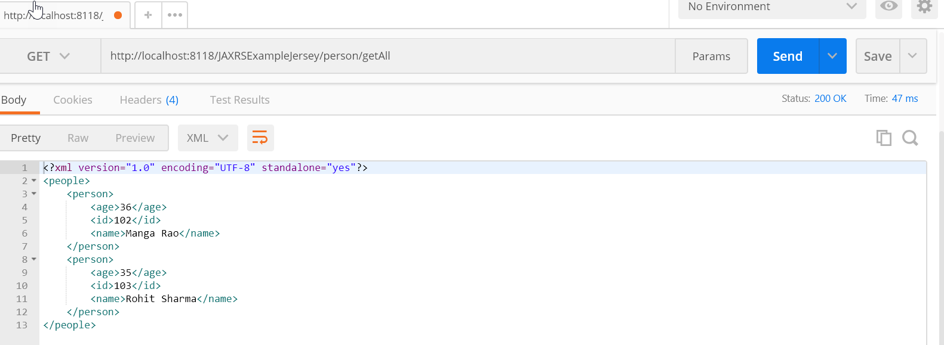
getAll

Slide 26
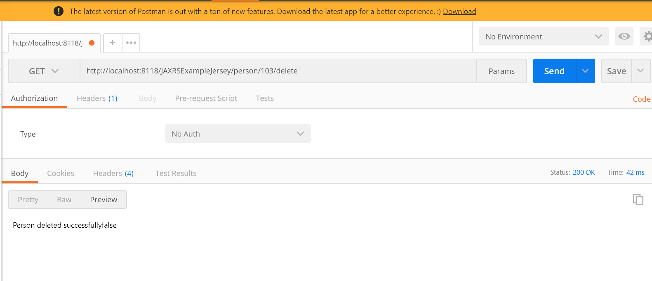
delete

Slide 27
RESTEasy RESTful Web Services Example
We use same business logic of Jersey project.
Rather than making changes to the same project, Let’s create a new project.
Create a dynamic web project and convert it to Maven project.
Then copy all the java classes – Person, Response, PersonService and PersonServiceImpl.
Below is the final project after done with all the changes.

Slide 28
Add below RESTEasy dependencies in pom.xml file.
<dependency>
<groupId>org.jboss.resteasy</groupId>
<artifactId>resteasy-jaxrs</artifactId>
<version>3.0.13.Final</version>
</dependency>
<dependency>
<groupId>org.jboss.resteasy</groupId>
<artifactId>resteasy-jaxb-provider</artifactId>
<version>3.0.13.Final</version>
</dependency>

Slide 29
Add RestEasy servlet in web.xml
<listener>
<listener-class>
org.jboss.resteasy.plugins.server.servlet.ResteasyBootstrap
</listener-class>
</listener>
<servlet>
<servlet-name>resteasy-servlet</servlet-name>
<servlet-class>
org.jboss.resteasy.plugins.server.servlet.HttpServletDispatcher
</servlet-class>
<init-param>
<param-name>javax.ws.rs.Application</param-name>
<param-value>com.mangaraoit.jaxrs.resteasy.app.MyApp</param-value>
</init-param>
</servlet>
<servlet-mapping>
<servlet-name>resteasy-servlet</servlet-name>
<url-pattern>/*</url-pattern>
</servlet-mapping>

Slide 30
Note:
Notice: We are providing init-param value as MyApp class.
Here we are extending javax.ws.rs.core.Application class as shown below.

Slide 31
MyApp
package com.mangaraoit.jaxrs.resteasy.app;
import java.util.HashSet;
import java.util.Set;
import javax.ws.rs.core.Application;
import com.mangaraoit.jaxrs.service.PersonServiceImpl;
public class MyApp extends Application {
private Set<Object> singletons = new HashSet();
public MyApp() {
singletons.add(new PersonServiceImpl());
}
@Override
public Set<Object> getSingletons() {
return singletons;
}
}

Slide 32
RESTEasy Web Services Test
That’s it. Deploy the application. Our web service is ready with RESTEasy JAX-RS implementation.

Slide 33
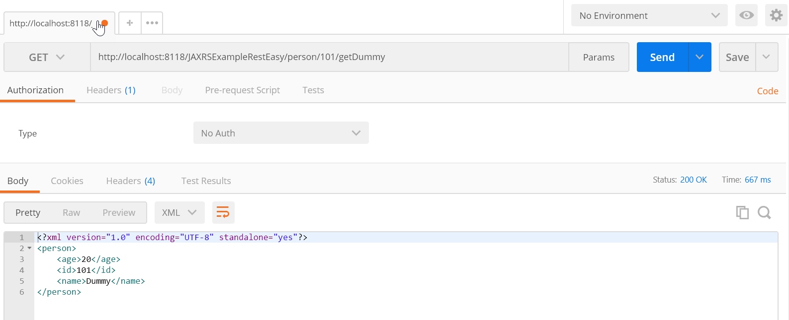
getDummy

Slide 34
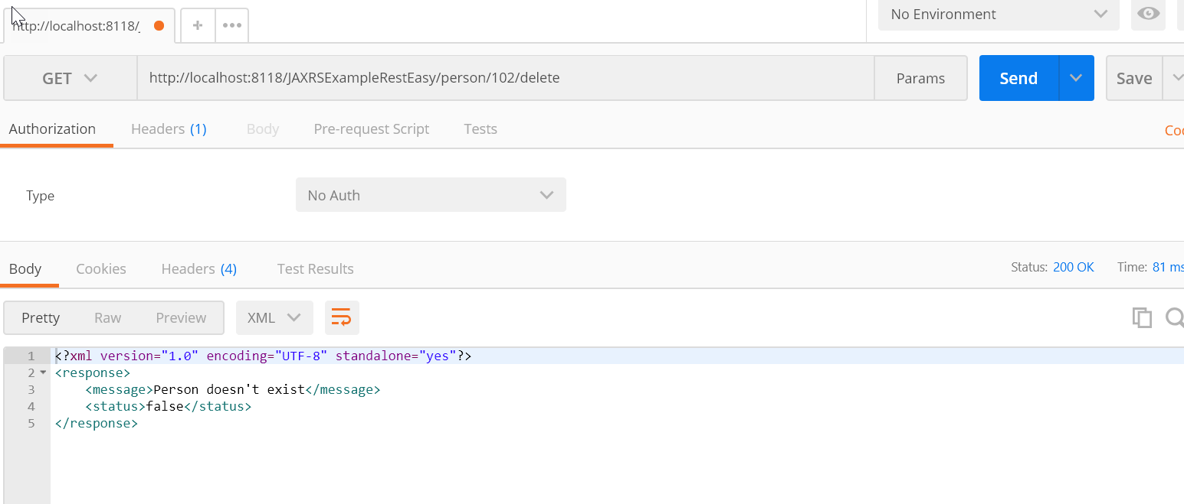
delete

Slide 35
Spring Boot REST Example
Spring Boot is an awesome module from Spring Framework. Once you are used to it, then working with Spring is a breeze because it takes care of all the spring container specific configurations and allows us to focus more on our application.
REST web services are very popular these days. Let’s create a REST Service using Spring boot.

Slide 36
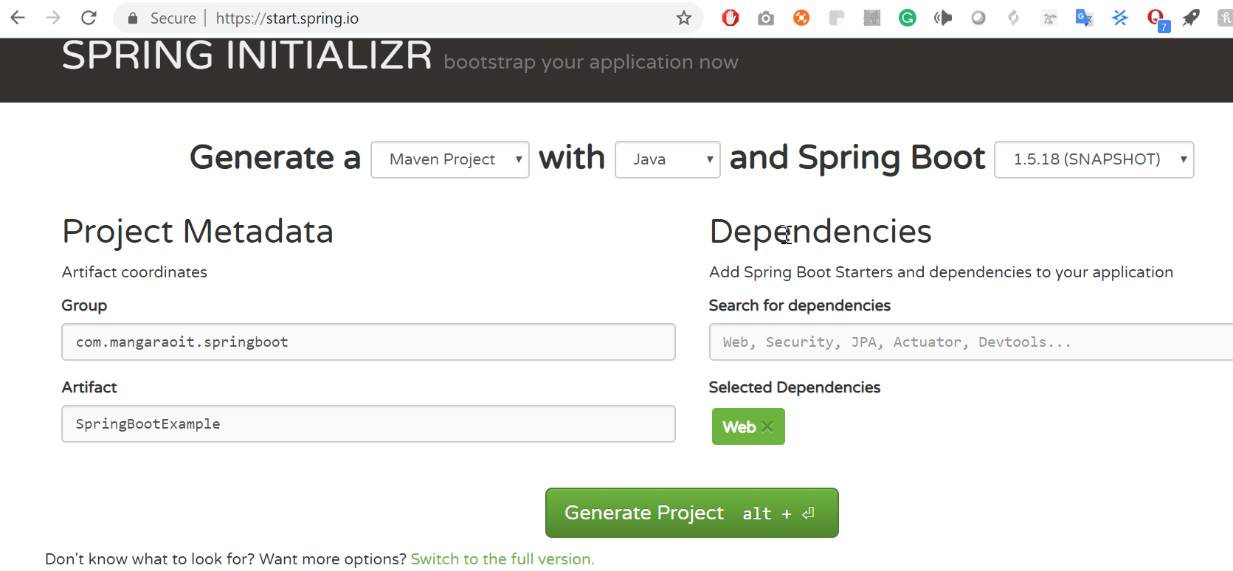
Spring Boot REST Dependencies
Since web applications run on the server, apart from Spring Boot we need to add Spring MVC libraries to our project.
Let’s use Spring Initializr to create Spring Boot project. Enter details and click on Generate Project button. Add Web module.

Slide 37
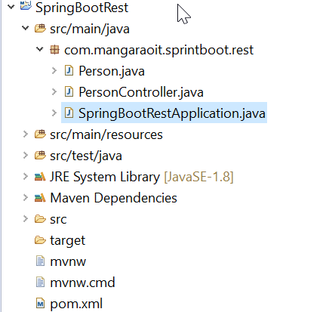
Import the generated maven project into Eclipse - Directory structure

Slide 38
Issue 1: org.apache.maven.archiver.MavenArchiver.getManifest(org.apache.maven.project.MavenProject, org.apache.maven.archiver.MavenArchiveConfiguration) pom.xml /<maven projectName>
The solution was to downgrade the spring-boot-starter-parent dependency version from 2.0.0.RELEASE to 1.5.10.RELEASE(you can move to any stable version)
<parent>
<groupId>org.springframework.boot</groupId>
<artifactId>spring-boot-starter-parent</artifactId>
<version>2.0.0.RELEASE</version> / <version>1.5.10.RELEASE</version>
<relativePath/> <!-- lookup parent from repository -->
</parent>

Slide 39
Issue 2: project configuration is not up-to-date with pom.xml
Solution: Go to package explorer
Right-click the project
Select Maven\Update Project
Worked perfectly

Slide 40
Notes
Most important of these is SpringBootRestApplication class that is configured as Spring Boot application and contains java main method. When we run this class, it automatically runs our project as Spring Boot Web project.
If we will check the console logs, it should print Tomcat started on port(s): 8080 (http) with context path ‘’.
Now that our base Spring Boot REST application is ready, Let’s add some endpoints and business logic to it.

Slide 41
We will use a java bean class for sending REST web service response. Here is the code for it. Person.java
package com.mangaraoit.sprintboot.rest;
import org.springframework.stereotype.Component;
@Component
public class Person {
private String name;
public String getName() {
return name;
}
public void setName(String name) {
this.name = name;
}
}

Slide 42
Spring REST Endpoints Configuration
We create a @RestController and add some methods and annotate them with @RequestMapping.
Below is our REST Controller class that exposes few GET and POST endpoints.

Slide 43
PersonController.java
package com.mangaraoit.sprintboot.rest;
import org.springframework.beans.factory.annotation.Autowired;
import org.springframework.web.bind.annotation.RequestMapping;
import org.springframework.web.bind.annotation.RequestParam;
import org.springframework.web.bind.annotation.RestController;
@RestController
public class PersonController {
@Autowired
private Person person;
@RequestMapping("/")
public String healthCheck(){
return "OK";
}
@RequestMapping("/person/get")
public Person getPerson(@RequestParam(name="name", required=false,defaultValue="unknown") String name){
person.setName(name);
return person;
}
@RequestMapping(value="/person/update", method=RequestMethod.POST)
public Person UpdatePerson(@RequestParam(name="name", required=true) String name){
person.setName(name);
return person;
}}

Slide 44
Notes
When we annotate the controller class with @RestController, Spring Boot scans it to find the REST endpoints to configure.
@RequestMapping annotation on methods tells Spring to use this method as handler for any client requests. This is very important spring annotation, we can configure additional features such as HTTP methods supported, Content-Type of request, response content type etc. By default, GET method is supported and JSON response is returned.

Slide 45
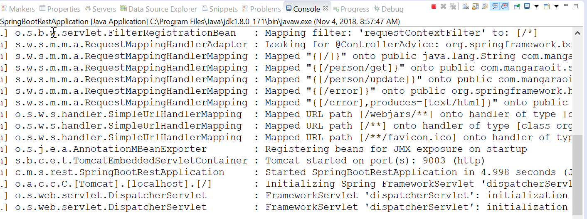
Spring Boot REST Web Service Test
run the main class, check the logs for endpoints configuration.

Slide 46
Spring boot - change default port of embedded server
Open application.properties

Slide 47
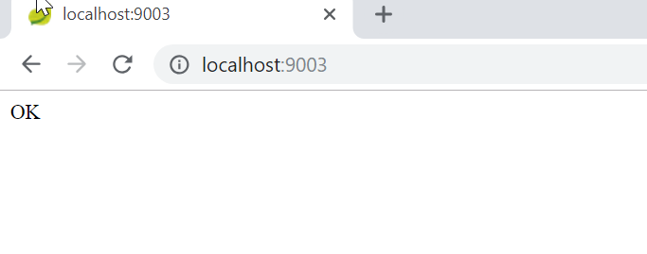
Get request can be tested through browser

Slide 48
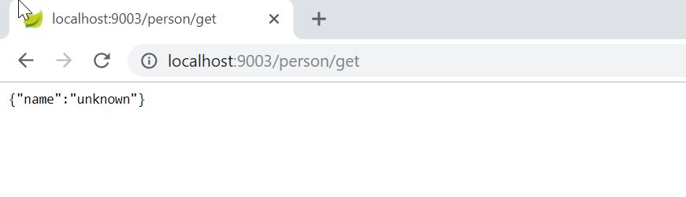
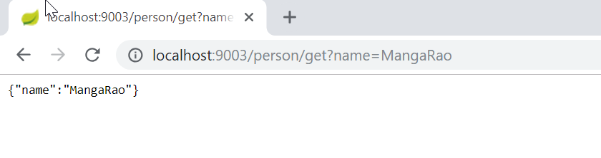

Slide 49
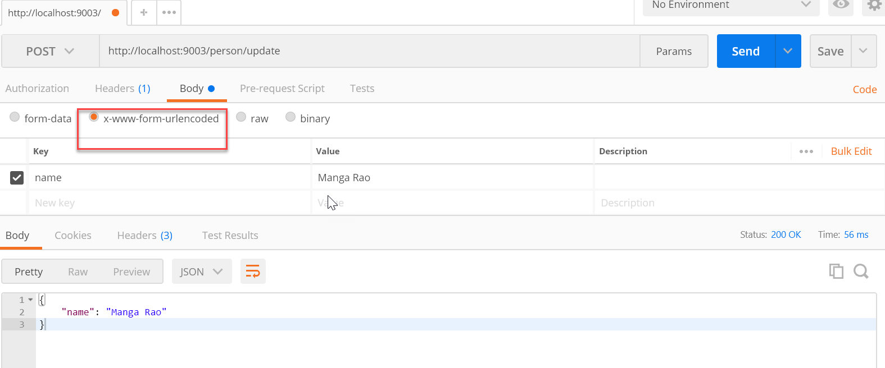
Postman app for testing POST requests.

Slide 50
Spring Boot REST JSON Request Response
JSON is the standard messaging format for REST web services.
We are accepting String as POST request, let’s change our method to accept JSON request.
@RequestMapping(value="/person/update", method=RequestMethod.POST, consumes = "application/json")
public Person UpdatePerson(@RequestBody Person p){
person.setName(p.getName());
return person;
}

Slide 51
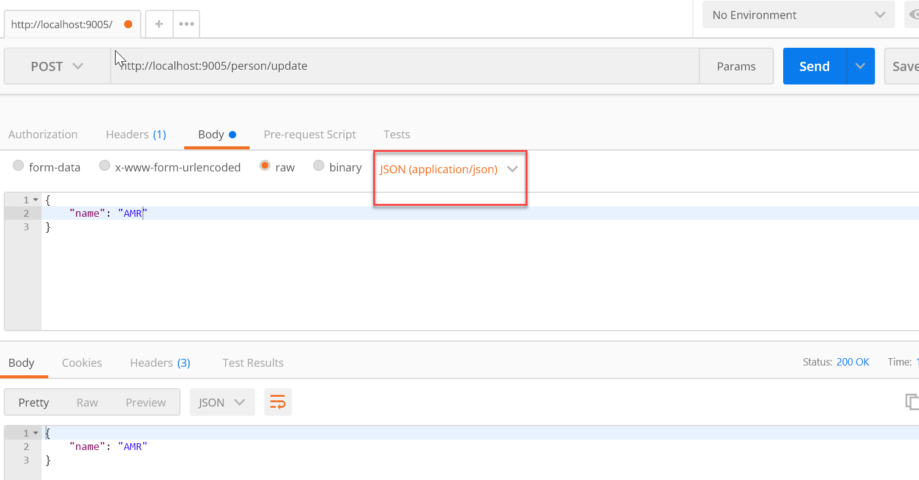
Output

Slide 52
Source: https://www.journaldev.com

